Slide 1
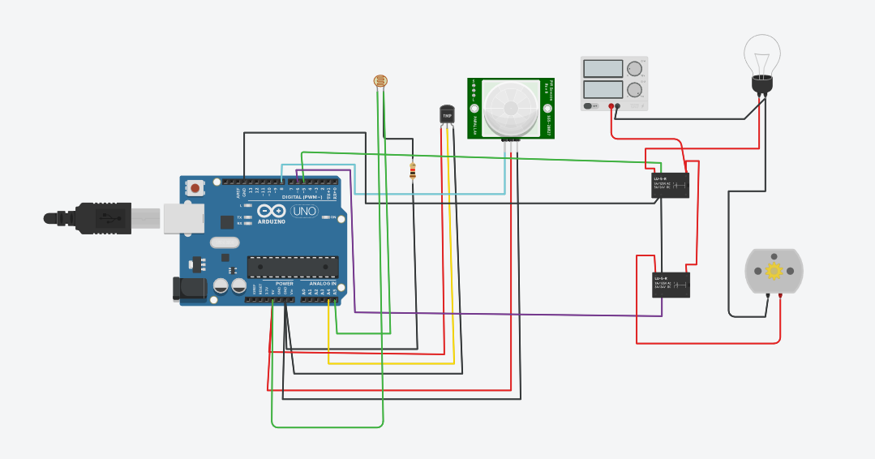
Smart Home Using Sensors
Circuit Diagram

Slide 2
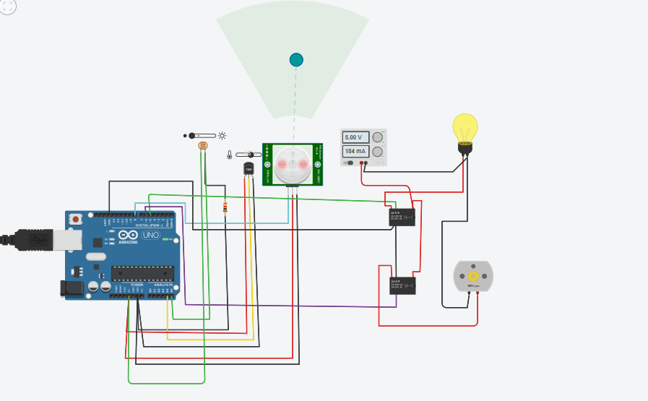
Total Operating System is only working when the PIR sensor is active.PIR-passive infrared sensor.
Total
When the temperature of the sensor is more than 30 degree celcious then automatically the fan will TURN ON .
When LDR detected Dark ,it will TURN ON light bulb.

Slide 3
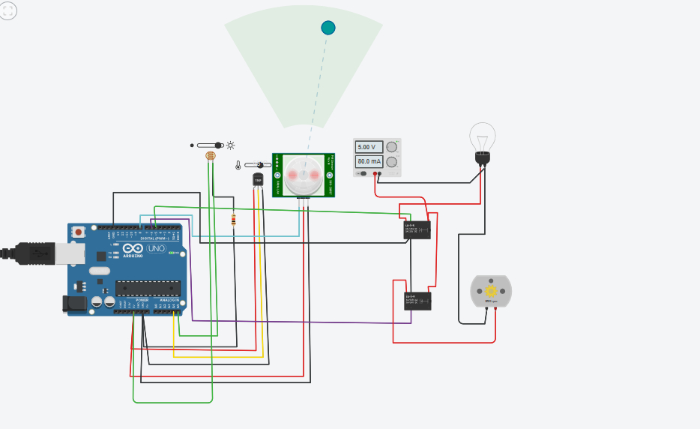
At Day time bulb is automatically TURN OFF .

Slide 4
When no one is in front of PIR sensor the WHOLE SYSTEM will be TURN OFF.

Slide 5
SIMULATION CODE
float x,y,z,temp;
void setup(){ pinMode(8, INPUT);
pinMode(5, OUTPUT);
pinMode(6, OUTPUT);
pinMode(A5, INPUT);
pinMode(A4, INPUT);
Serial.begin(9600);
}
void loop(){
x= digitalRead(8);
y= analogRead(A5);
z= analogRead(A4);
Serial.println(x);
Serial.println(y);
Serial.println(z);
temp = (double)z / 1024;
temp = temp * 5;
temp = temp - 0.5;
temp = temp * 100;
if ( (x>0) ) {
if ((y<550)&&(temp>30)) {
digitalWrite(5, HIGH);
digitalWrite(6, HIGH);
}
else if((y<550)&&(temp<30)) {
digitalWrite(5, HIGH);
digitalWrite(6, LOW);
}
else if((y>550)&&(temp>30)) {
digitalWrite(5, LOW);
digitalWrite(6, HIGH);
}
else if((y>550)&&(temp<30)) {
digitalWrite(5, LOW);
digitalWrite(6, LOW);
}
}
else {
digitalWrite(5, LOW);
digitalWrite(6, LOW);
}
}

